Slide 1
Week 2A – Introduction to LabVIEW
Advanced Mechatronics System Design – MANU2451
Dr Chow Yin LAI
Edited by Dr Milan Simic School of Engineering RMIT University, Victoria, Australia Email: milan.simic@rmit.edu.au

Slide 2
Teaching Schedule
Week |  | Class Activity Before | Lecture | Class Activity During or After
1 |  |  | Introduction to the Course / Introduction to LabVIEW | LabVIEW Programming
2 |  |  | Introduction to LabVIEW / Data Acquisition | LabVIEW Programming
3 |  |  | Gripper / Introduction to Solidworks / Safety | Gripper Design
4 |  |  | Sensors I | myRIO Programming for Sensor Signal Reading / Gripper Design
5 |  |  | Sensors II | myRIO Programming for Sensor Signal Reading
6 |  |  | Actuators I | 3D Printing
7 |  | LabVIEW Assessment. | DC Motors I | Matlab Simulink Simulation
8 |  | Design report submission | DC Motors II | Matlab Simulink Simulation / myRIO Programming for Control
9 |  |  | Actuators II | Matlab Simulink Simulation / Assemble Gripper
10 |  |  | Modeling and System Identification | Matlab Simulink Simulation / Test Gripper
11 |  |  | Artificial Intelligence I | Matlab Simulation / Finalize Gripper
12 |  | Gripper Demonstration / Submission of Report | Artificial Intelligent II | Revision

Slide 3
Content
Controlling Program Execution with Structures
Charts & Graphs
File Input / Output

Slide 4
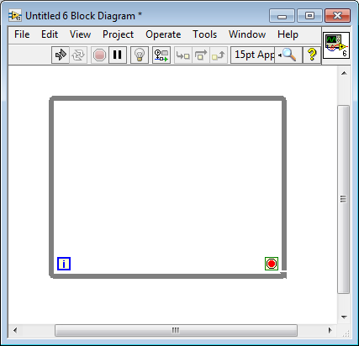
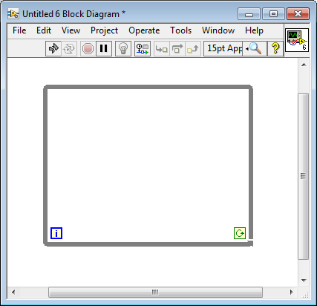
While Loops
In one of our previous example, it was shown that the While Loop allows the program to run continuously until we order it to stop (left).
We can also change it to run continuously when we order it to do so (right).

Slide 5
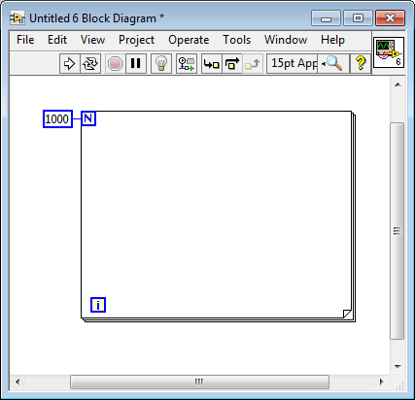
For Loops
A “For Loop” executes the codes inside the border for a total of “count” times.
In e.g. “count” = 1000.
Difference with While loop:
While loop continues running until you press stop;
For loop continues for a predetermined times, then stops by itself.
E.g. get heights of 1000 people and find the average.

Slide 6
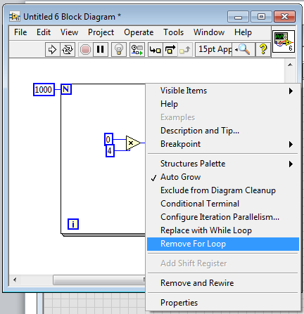
Removing Structure
BE CAREFUL!!
If you click on the loop and press delete, you will delete everything within the loop as well!
You should instead right click on the loop → pop-up menu → Remove For Loop / Remove While Loop to do this.

Slide 7
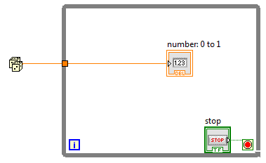
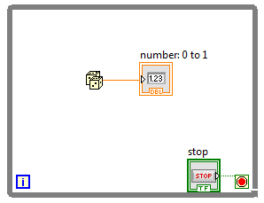
Data Flow with Loops
Data passes into and out of a loop through a little box on the loop border called a “tunnel”.
Left: the random number passes only 1 value into the loop, and then the loop executes continuously.
You will only see the 1st value of the random number.
Right: The random number also runs continuously.

Slide 8
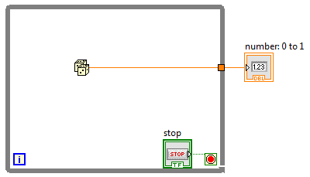
Data Flow with Loops
Left: The indicator reads values from the random number continuously.
Right: The indicator reads only the final value of the random number generator.
→ Loop outputs pass data out only after the loop completes all iteration!

Slide 9
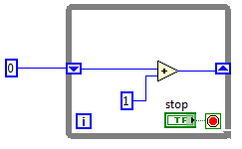
Shift Registers
To transfer values from one iteration of a loop to the next.
E.g. you want to detect a change from 0 to 1.
At the current instant (now) you can check: If the value now is 1 and the value just before this iteration is 0, then the change is detected.
Or you want to make a ramp up:
Before loop begins
First iteration
Second iteration
0 (initial value)
1
2
1
2
3

Slide 10
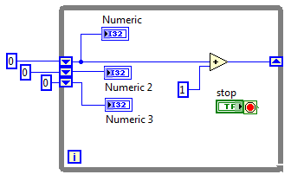
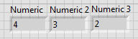
Shift Registers
You can create the shift register by right click on the loop → Pop-up → Add Shift Register.
Or, if you already have a output tunnel, you can pop up the tunnel → Replace with Shift Registers.
In the previous example, you only hold the previous value once.
You can also hold values from more of previous iterations:
Pop-up the left terminal → Add elements

Slide 11
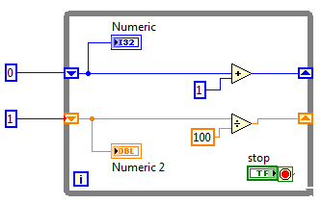
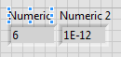
Shift Registers
Do not be confused by “Add Elements” and “Add Shift Registers”
The element holds values of a few previous loops
The two shift registers hold two values from the same previous loop

Slide 12
Shift Registers
Important! You should always initialize your shift registers.
To avoid unforeseen behaviour.
0 (initial value)

Slide 13

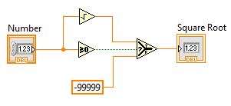
If.. Then.. Else..
If you need to make a simple decision between true choices:
(Block Diagram) → Pop up → Comparisons → Select
There are three input terminals:
Top: Pass through this signal to the output, if condition is true
Middle: The condition
Bottom: Pass through this signal to the output, if condition if false
E.g.
If number is positive (or zero), calculate square root.
If number is negative, output -99999.

Slide 14
Exercise
Create a counter using the shift register.
When user clicks on a “reset” button (i.e. Boolean value jumps from 0 to 1 or vice versa), we want to reset the counter to start from zero.
Hint: Also use shift register to detect the change in state of reset button.
You will then use the If.. Then.. Else for actions when there is a state change and otherwise.

Slide 15
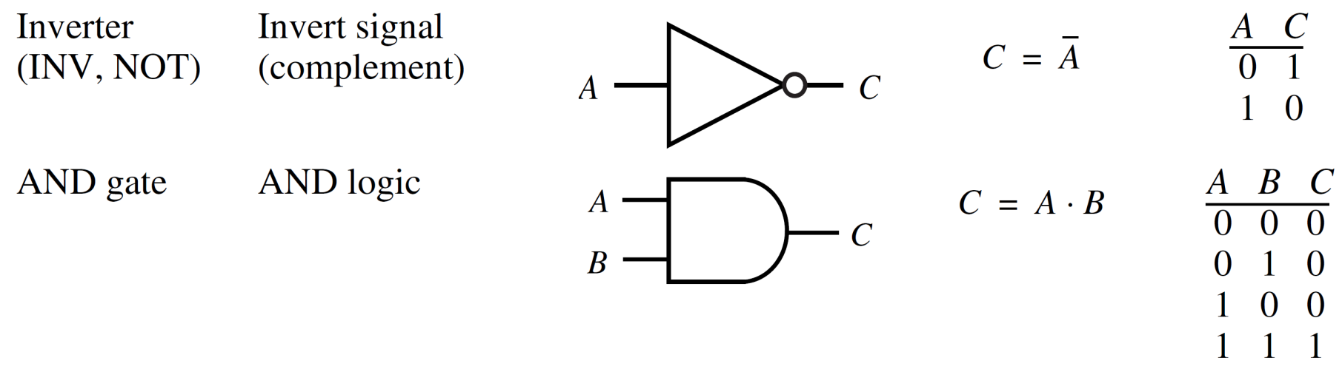
Logic Gates
Combinational logic devices: Digital systems that convert binary inputs into binary outputs based on the rules of mathematical logic
Logic gates: Components responsible for basic operations in combinational logic devices.

Slide 16
Logic Gates

Slide 17
Logic Gates
Algebraic symbols:
plus (+) for logic OR
dot (·) for the logic AND
an overbar or prime for logic NOT, denoting inversion.

Slide 18
Combinational Logic
Example
A | B | C | D | E | F
0 | 0 | 0 | 0 | 1 | 0
0 | 0 | 1 | 0 | 0 | 1
0 | 1 | 0 | 0 | 1 | 0
0 | 1 | 1 | 0 | 0 | 1
1 | 0 | 0 | 0 | 1 | 0
1 | 0 | 1 | 0 | 0 | 1
1 | 1 | 0 | 1 | 1 | 0
1 | 1 | 1 | 1 | 1 | 1
A B C
D
E
F

Slide 19
Exercise
Continuing from the previous example where you created a shift register and “reset” function
Now, the reset will only happen if:
The counter value is more than 50;
Or, the reset will also happen automatically if the counter reaches 200;
Reset button does not need to be pressed.

Slide 20
Case Structure
The If… Then… Else… is useful if you only have simple decisions to make.
However, if you have lots of options, the Case Structure will be more handy.
The options can be:
Boolean: Just true or false – similar to If… Then… Else
Numeric: 1, 2, 3, 4, …
E.g. What do you want to have for lunch? 1 – Pizza, 2 – Curry, 3 – MacDonald’s, 4 – Ramen, …
String: Jeff, Stephanie, John, Lisa, …
E.g. What is the height of: Jeff / Stephanie / John / Lisa / …

Slide 21
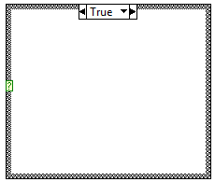
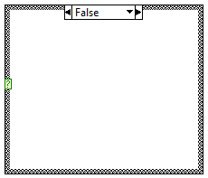
Case Structure
Found under Block Diagram → Structures → Case Structures
By default, the choice is Boolean. You can click on the downwards triangle beside the True to select False.
The green “?” on the left is the user-given choice.
You can move it up and down the structure if you want.

Slide 22
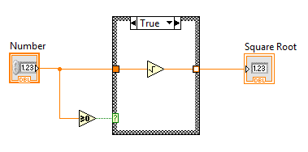
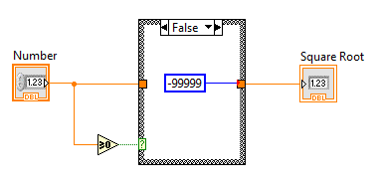
Case Structure
Let’s repeat the If… Then… Else example here:
Before you complete all the cases, this tunnel will have a white square in it.

Slide 23
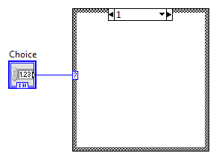
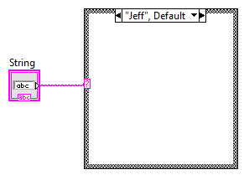
Case Structure
As mentioned, by default, the choice of case structure is Boolean.
Once you wire a numeric to the “?”, the cases change to numerical numbers.
Similarly, if you wire a string to the “?”, the cases change to strings, with “”.
For strings, you would have to change the value within “”.
There are originally only two cases. You can add more choices by pop-up on the downwards triangle → Add Case After.
Explore all other options as well.

Slide 24
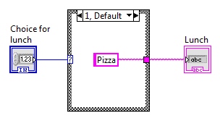
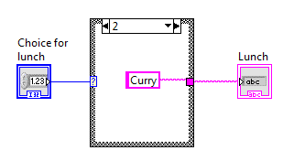
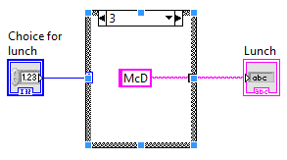
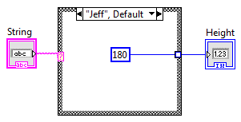
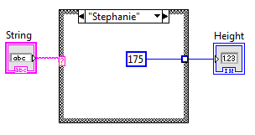
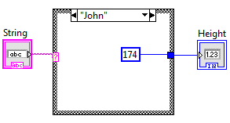
Case Structure
Lunch example:
Note: Delete 0 case, and make 1 default.
Name and height example:

Slide 25
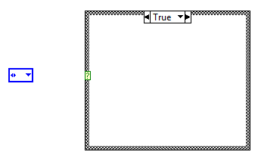
Case Structure
In previous examples, we need to key in the string control.
Care needs to be taken such that it is the same as given in the case.
Can we make a drop-down list?
Yes! Use Enum.
Enum

Slide 26
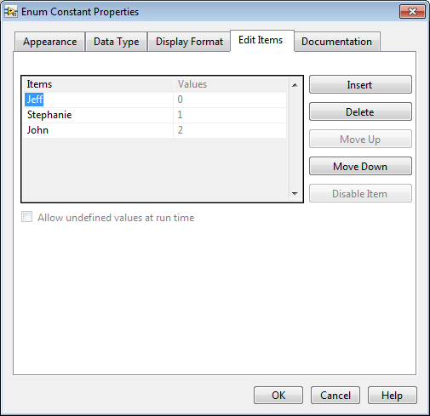
Case Structure
Right click on Enum → Properties → Edit items tab.
Use Insert, Move Up / Move Down etc. to key in the items.

Slide 27
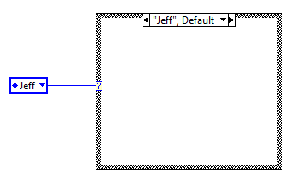
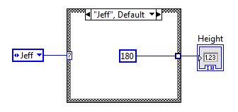
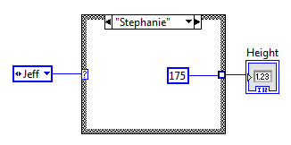
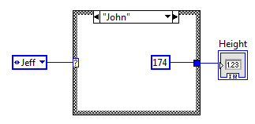
Case Structure
Now connect the Enum with the “?” of case structure.
You will see that the cases for Jeff and Stephanie are automatically created.
Pop-up on the case, and select “Add Case After”. The case for John is also automatically created.
Finish up the VI.

Slide 28
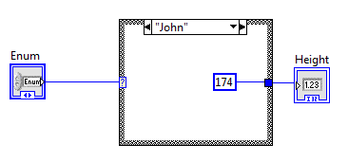
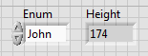
Case Structure
If you look at the front panel now, you will see that unfortunately, there is no list of name for you to choose!
Right click on Enum → Change to Control
Now the list appears in front panel and you can run your program.

Slide 29
Exercise
Create a case structure for 5 persons (Andy, Belinda, Christina, David, Eric).
In each case, give their height (in m) and weight (in kg) as constants.
Outside of the case, calculate the Body Mass Index:
BMI = weight / (height^2)

Slide 30
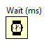
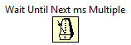
Timing
Block diagram → Pop-up → Timing
Wait (ms): VI to wait a specified number of milliseconds before it continues execution.
Forces the loop to execute every n ms, as long as all the code in the loop already executes in less than n ms.
Otherwise the loop executes only as fast as the code inside.
Wait Until Next ms Multiple: Wait until internal clock equals or passed a multiple of millisecond.
Useful for synchronizing activities.
Note: Software-timed structure always have some level of jitter to the timing of a loop.
We will see how to use hardware clock for more accurate timing next week.

Slide 31
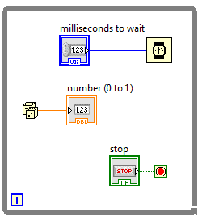
Timing
Example: Timing + While loop
Try changing the milliseconds to wait and see response on indicator.

Slide 32
Content
Controlling Program Execution with Structures
Charts & Graphs
File Input / Output

Slide 33
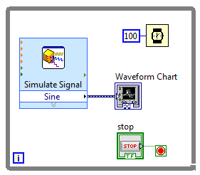
Waveform Charts
Most often used inside loops.
Charts retain and display previously acquired data, and append new data as they become available.
Continuously updating display.
Y represents data, X represents time (loop number).
Three update modes:
Strip chart, Scope chart and Sweep chart.
Pop-up → Advanced → Update Mode.

Slide 34
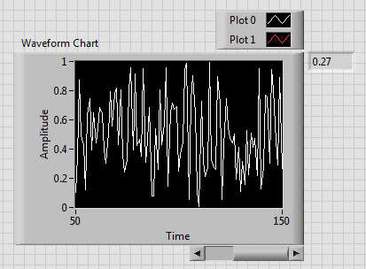
Waveform Charts - Options
Show the digital display
Displays the most recent value
Pop-up → Visible Items → Digital display
Show the X scrollbar
Use scrollbar to display older data that has scrolled off the chart
Pop-up → Visible Items → X scrollbar
Clear chart
Useful for new measurement.
Pop-up → (Data Operations) → Clear chart

Slide 35
Waveform Charts - Options
Chart History Length
Default: 1024 data points.
To store more or fewer data: Pop-up Chart → Chart History Length → Enter between 10 and 2,147,483,647 points.
Note: This does not affect how much data are shown on screen!
Rather: how much data can be scrolled back through.

Slide 36
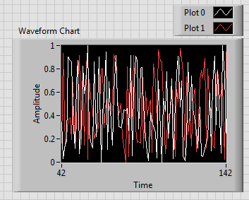
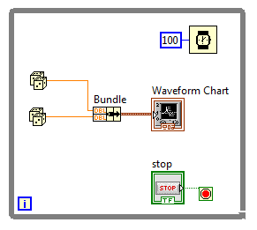
Multiple-Plot Chart
Use bundle to bring multiple data together, before passing into the single input port of the chart.

Slide 37
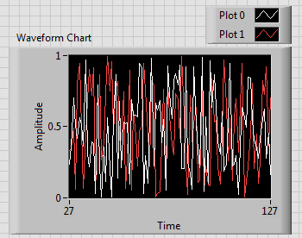
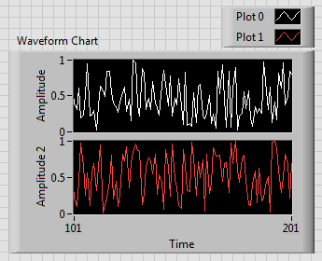
Multiple-Plot Chart: Options
Overlaid (Left) or Stacked (Right) Plots:
Pop-up when NOT running → Overlay or Stack

Slide 38
Graphs
Graphs plot arrays of data all at once.
They do not append new values to previously generated data (refer chart).
Type of graphs:
Waveform graphs
XY graphs
Intensity graphs
3D graphs
Etc.

Slide 39
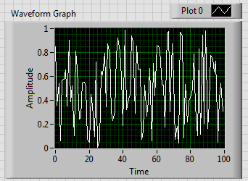
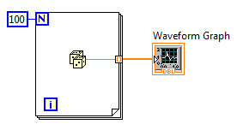
Waveform Graphs
Important: Input to waveform graph must be array (collection / “buffer” of data elements of the same type)!
To create array → Pop-up output tunnel → Tunnel Mode → Indexing
In the example above, the graph assumes time starts at 0, and the time between two elements is one (second).

Slide 40
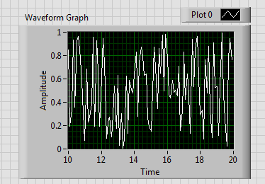
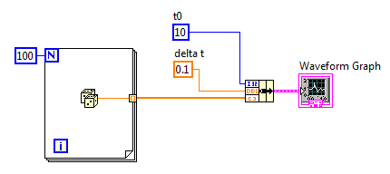
Waveform Graphs
You can change the assumed starting time and the time interval using bundle as follows:

Slide 41
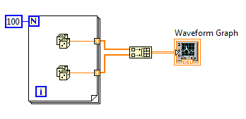
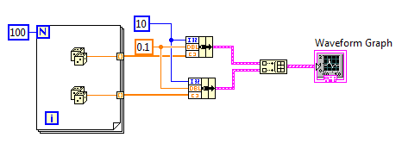
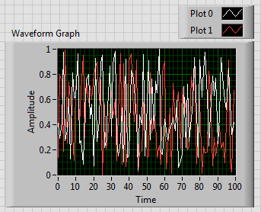

Multiple-Plot Waveform Graphs
For charts, we used bundle to combine more than one data for plotting.
For graphs, we use “build array” to combine more than one 1-D array:

Slide 42


Waveform Graph for Dynamic Data
Express Vis use a special data type called the dynamic data type (ddt).
One or more channels of waveform data.
Think of it as an array of analog waveform, wrapped in a very smart wire.
Found under “Express”

Slide 43


XY Graphs
For plotting relationship between X and Y.

Slide 44
Exercise
Users key in major axis (A) and minor axis (B).
Generate and plot an ellipse:
x^2 / A^2 + y^2 / B^2 = 1
Thus y = +/- sqrt (B^2 * (1 – x^2 / A^2))
Hint: x can be generated from “i” of for loop.
X and y need to be array.

Slide 45
Content
Controlling Program Execution with Structures
Charts & Graphs
File Input / Output

Slide 46
File Input / Output
Retrieve information from and store information in a disk file.
Block Diagram → Pop-up → File I/O
When called, the File I/O functions:
Open or create a file;
Read or write the data;
Then close the file
You can choose the format of file to be read / written
Text (LVM)
One-dimensional data
Easy to read when imported into spreadsheet or text editor
Binary (TDMS)
For large data
Excel (xlsx)

Slide 47



Express Writing
Example:
Test with different settings and compare the outcome!

Slide 48



Express Reading
Example
*(may need autoscale X)

Slide 49


Writing More than 1 Data
Example

Slide 50
Reminder
In the week 4, there will be a LabVIEW test
From 6.30pm – 7.30pm
Please be punctual
Practice:
Previous year’s tests will be given in Canvas for you to practise.
You are welcome to use the PC Lab; or
You can also use myDesktop to practise at home.

Slide 51

Thank you, Questions

